Slide 1
IBM x Columbia
Weekly Meeting
IBM x Columbia Core Team
10/9/2025

Slide 2
AGENDA
1
2
3
4
5
IBM x Columbia
10 / 2025
Why we're here today
Overview
Timeline
Team Check-in
Outcome Classification
Next Step

Slide 3
Overview
This weekly meeting will be focusing on establishing a clear roadmap and reviewing initial progress for the IBM x Columbia project. Including the timeline, team check-in, and some Q&A at the end.

Slide 4
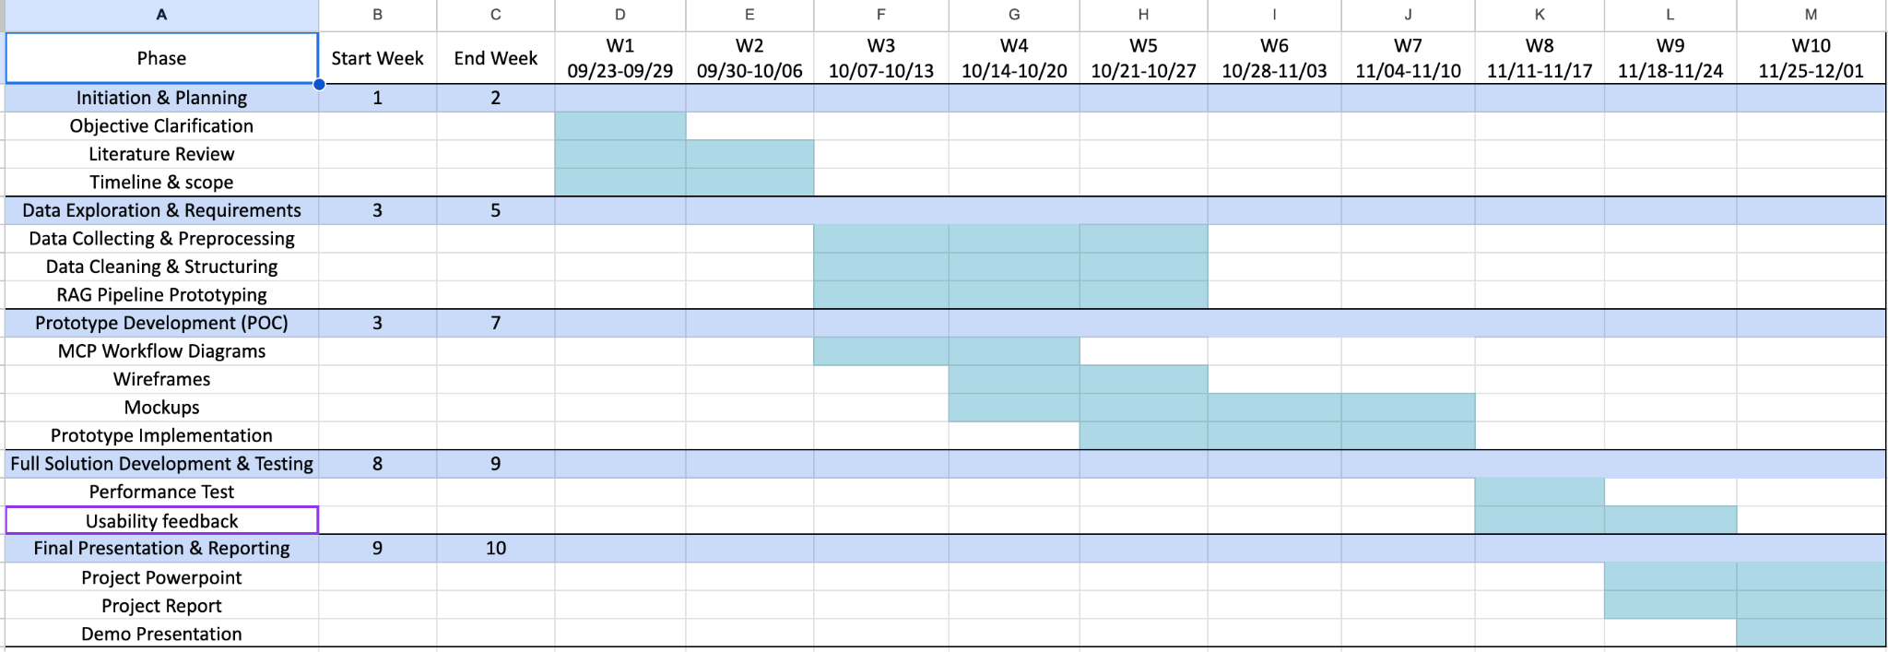
Timeline

Slide 5
Team Check-in
Domain & Requirements Team
Data & Knowledge Engineering Team
Generative AI & Model Development Team
User Experience & Application Development Team
Evaluation & Compliance Team

Slide 6
Domain & Requirement Team
Created a list of required documents and validated coverage of key processes.
Deep-dived into the EPLC framework and key deliverables
Standardized Core Document Types — Defined policies, templates, and checklists as mandatory inclusions.
Identified where generative AI adds value (content drafting, Q&A, navigation) — Defined potential AI applications to improve documentation efficiency and accessibility.

Slide 7
Data & Knowledge Engineering Team
Met with the Domain subteam to negotiate access to EPLC-related documents they collected.
Explored resources and tutorials on data extraction and cleaning techniques (PDF and DOC processing).
After communicating with the GenAI subteam, confirmed that our initial focus will be on the Development Phase templates.

Slide 8
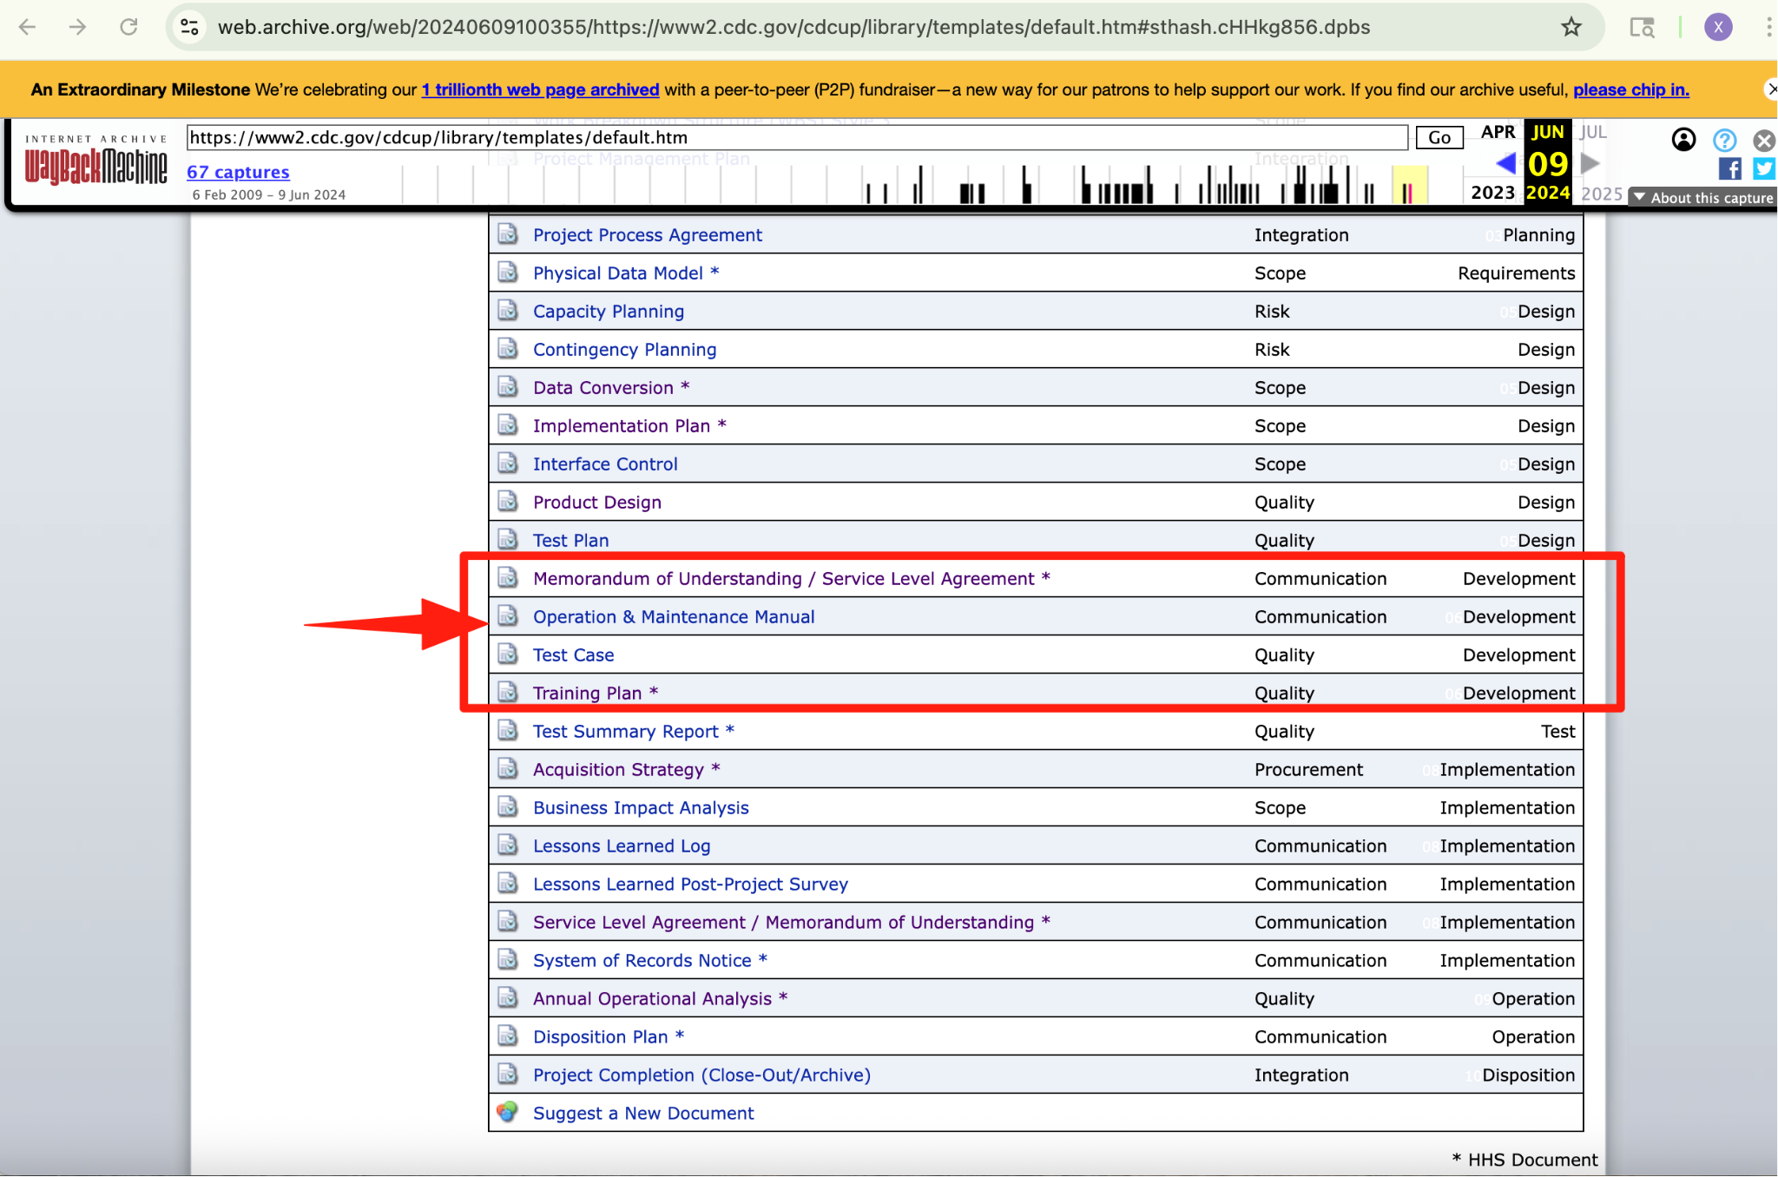
Data & Knowledge Engineering Team

Slide 9
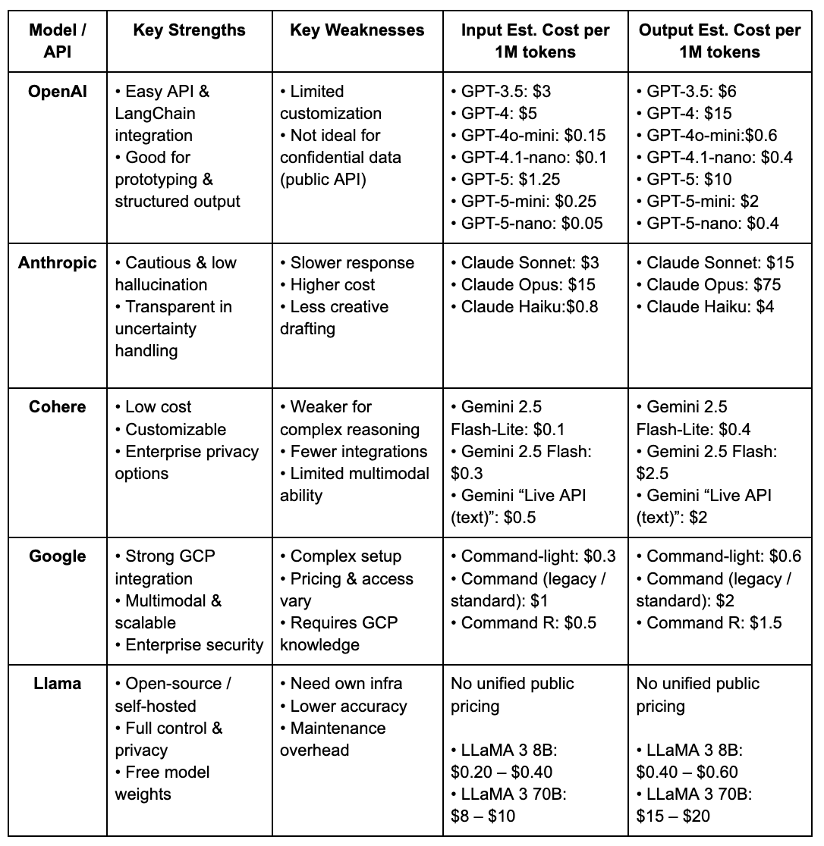
GenAI & Model Development
Conducted evaluation and comparison of multiple LLM APIs to identify the most suitable option for EPLC Chatbot development.
Selected OpenAI as the final choice
Excels in generating well-structured documents.
Demonstrates strong contextual understanding.
Ideal for prototyping through API integration。

Slide 10
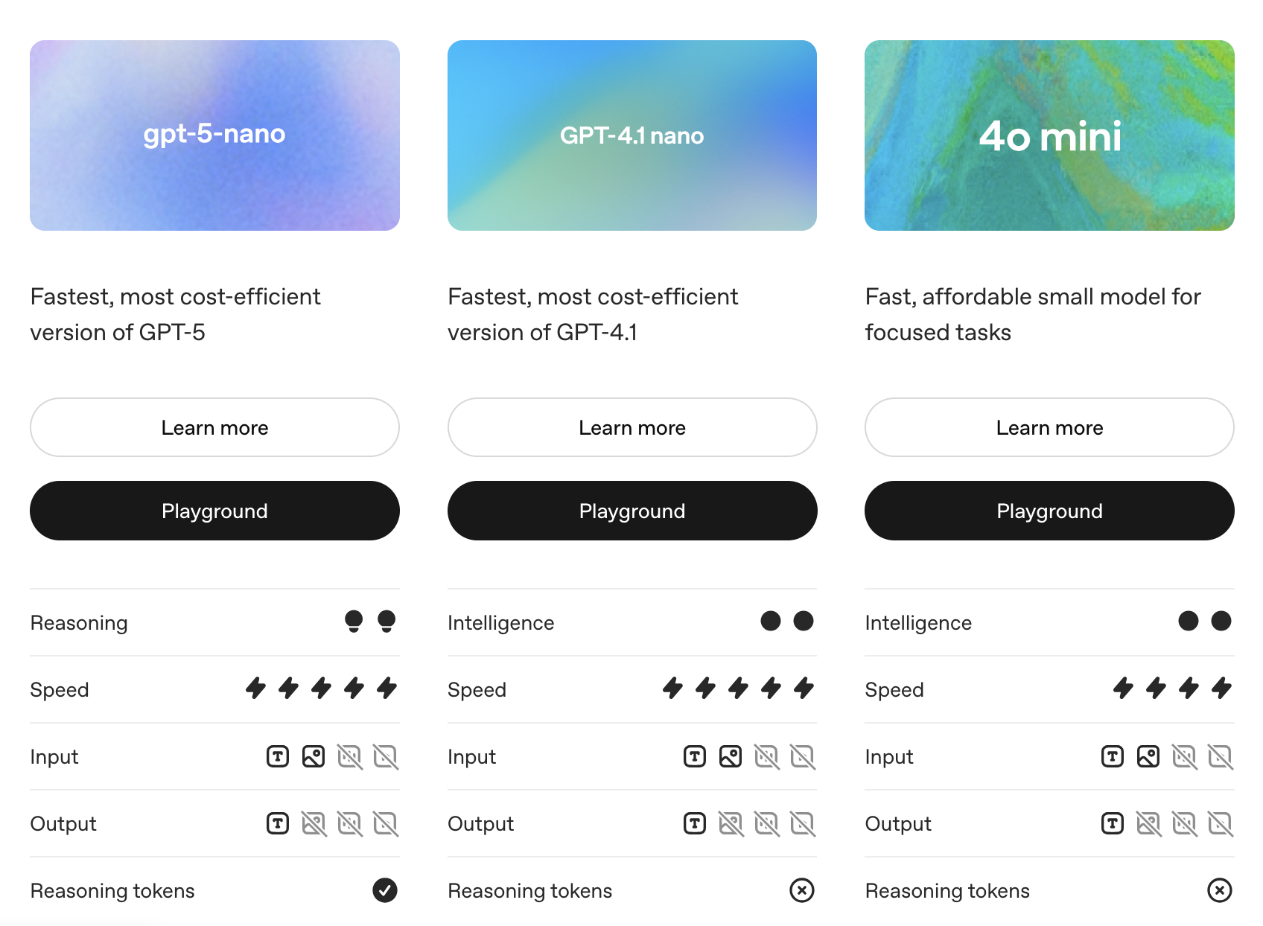
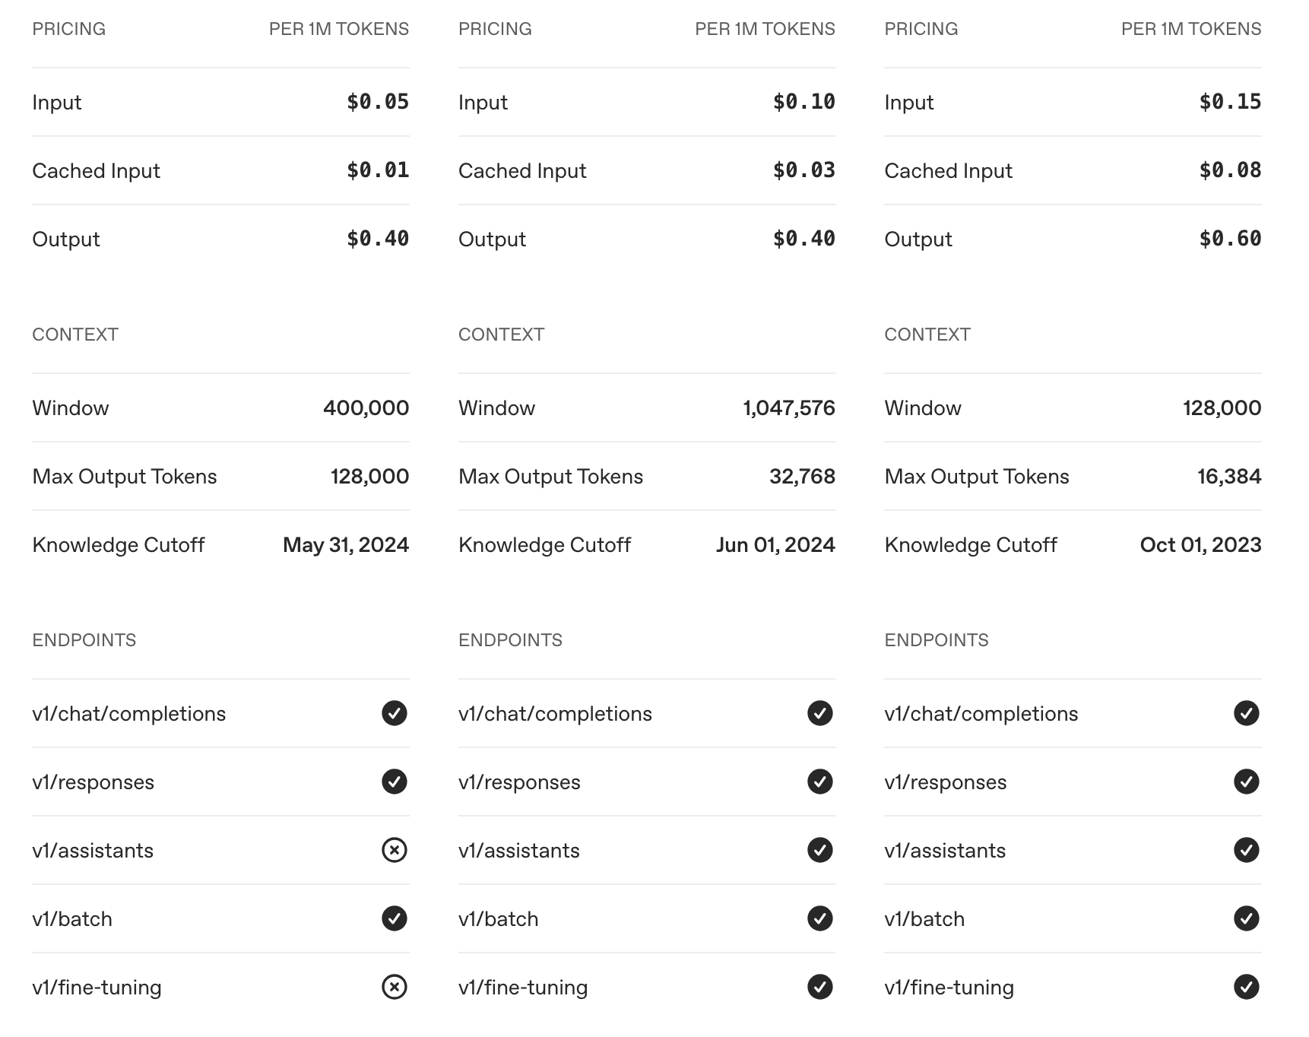
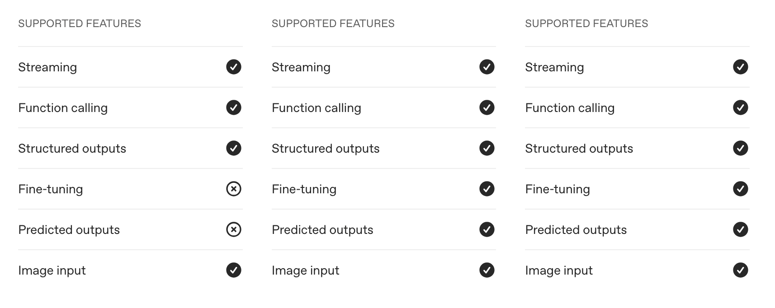
GenAI & Model Development

Slide 11
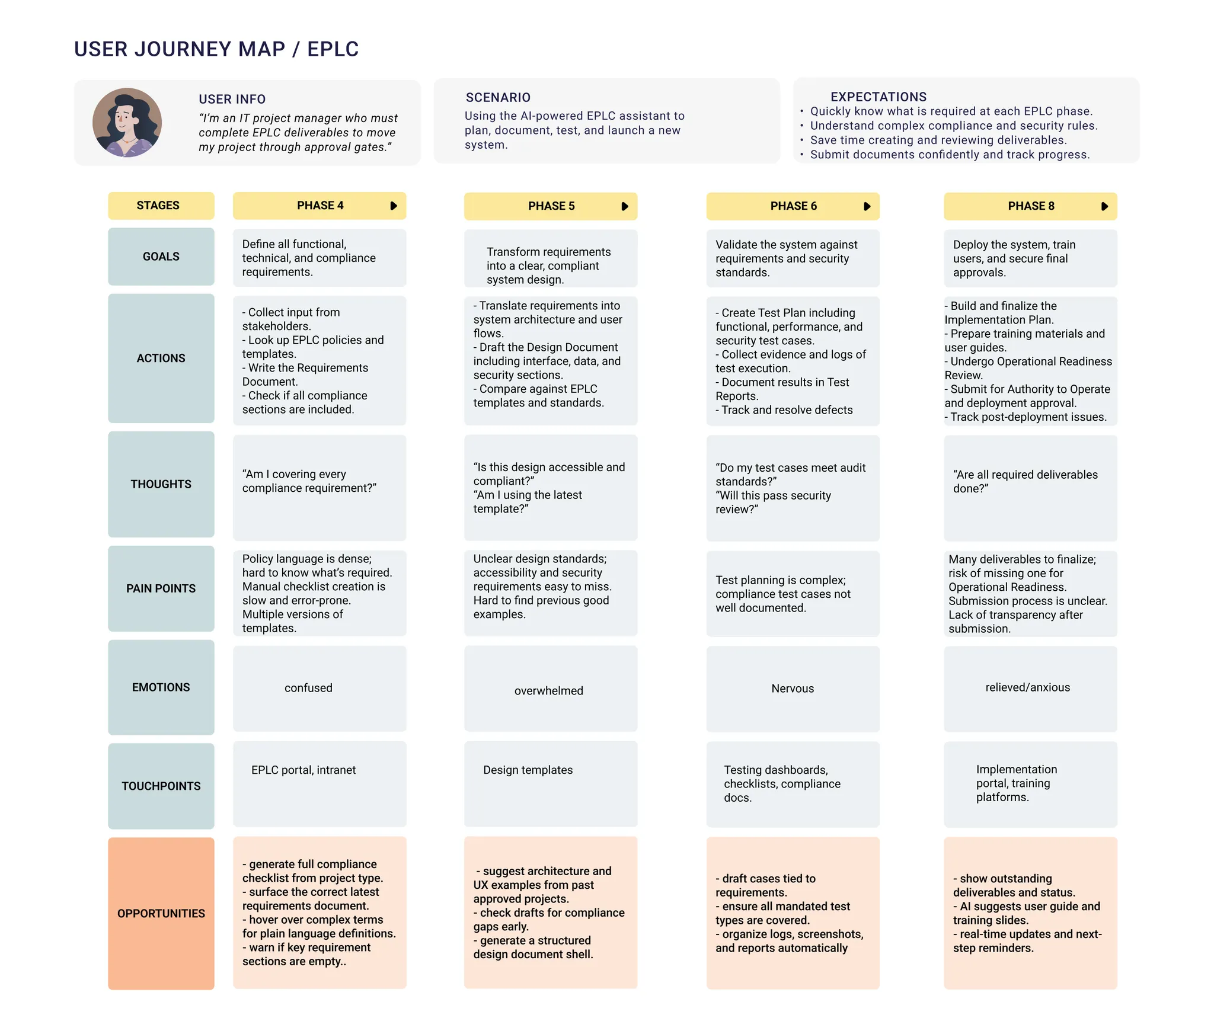
User Experience & Application Development Team
User Journey Map
Pain Point | Requirement
Hard to locate the proper paperwork/template | Navigating users to the correct paperwork
Don’t know whether content meet the policy requirements | Answering questions about requirements
Too many things to fill in | Assisting with generating content

Slide 12
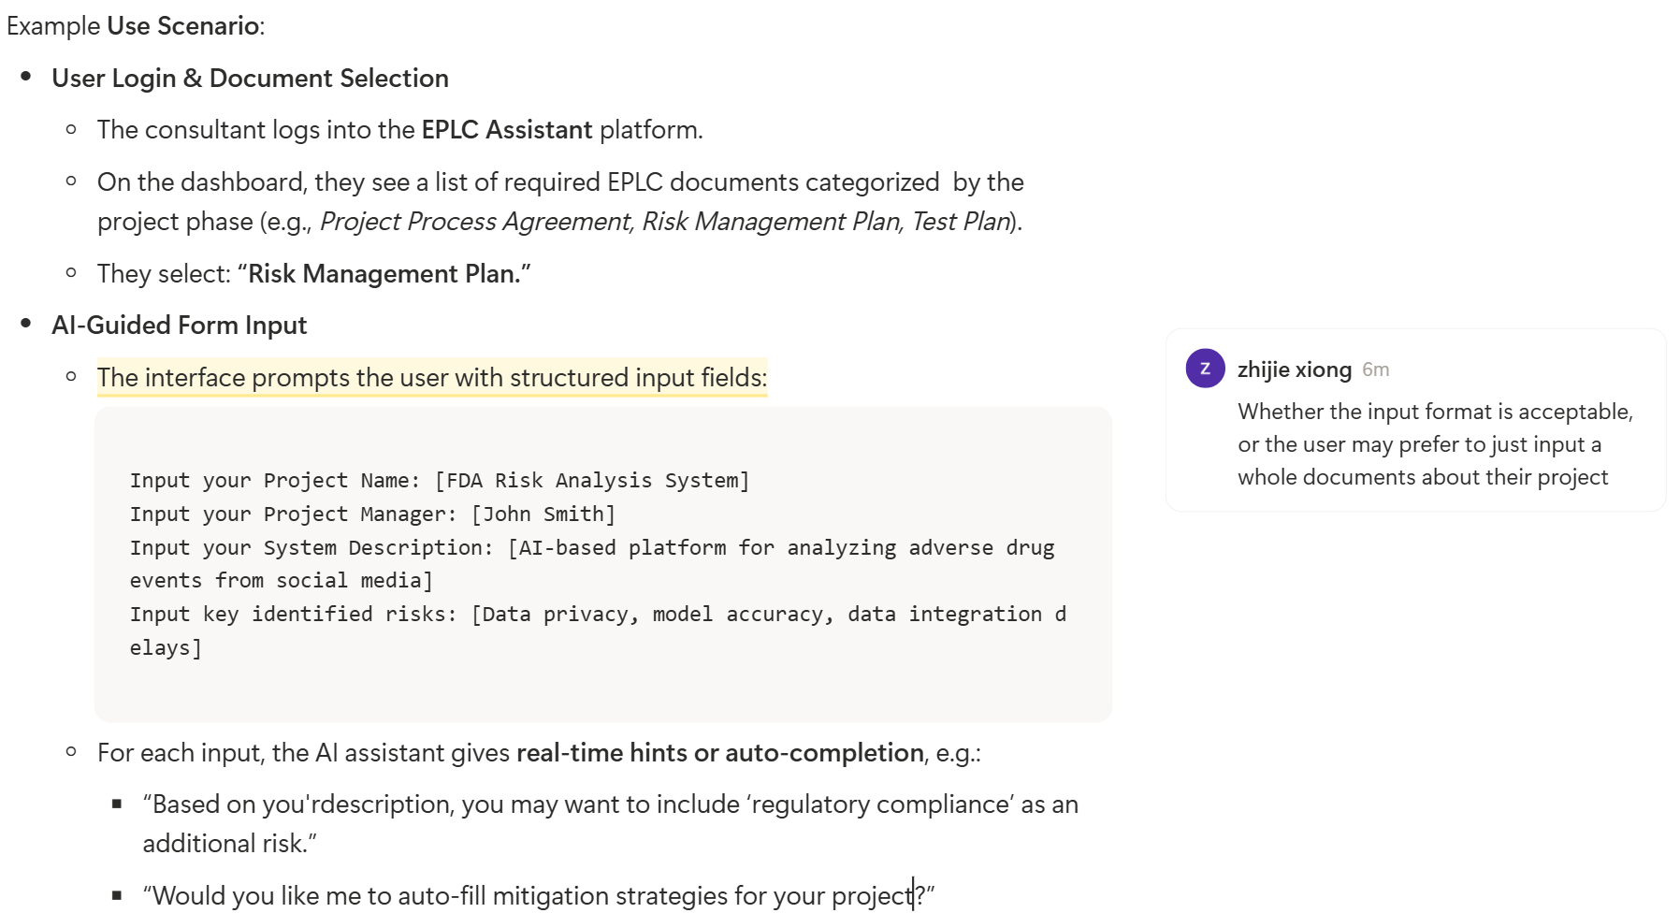
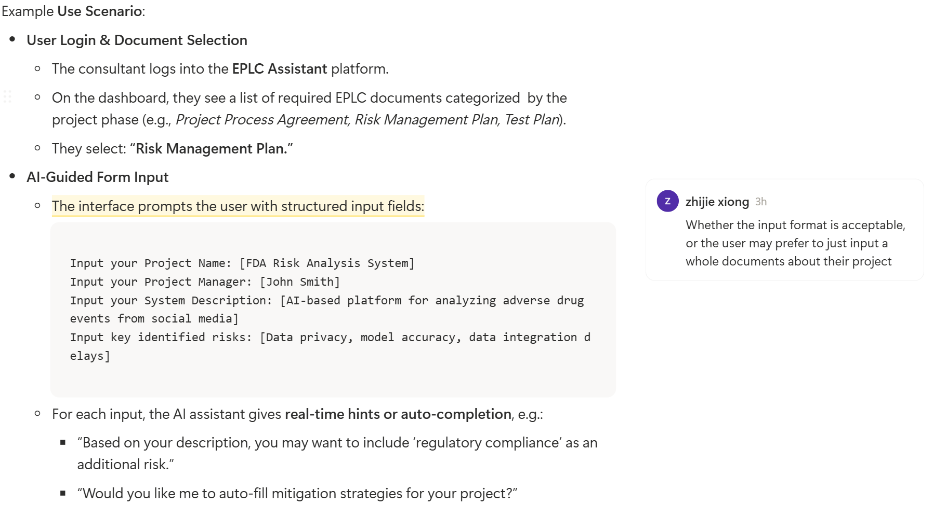
User Experience & Application Development Team
Solution: File helper +Chatbot
Whether the polish feature is needed, or user just need to know what should be fill in and they can write the content by themselves and AI just need to organize all of them to be a complete documents.

Slide 13
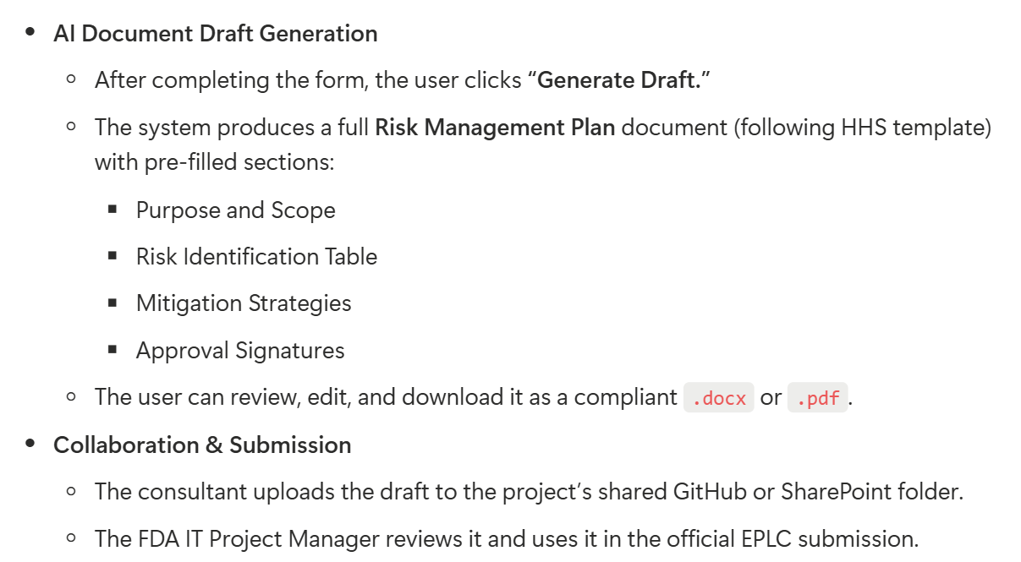
User Experience & Application Development Team
Solution: File helper +Chatbot

Slide 14
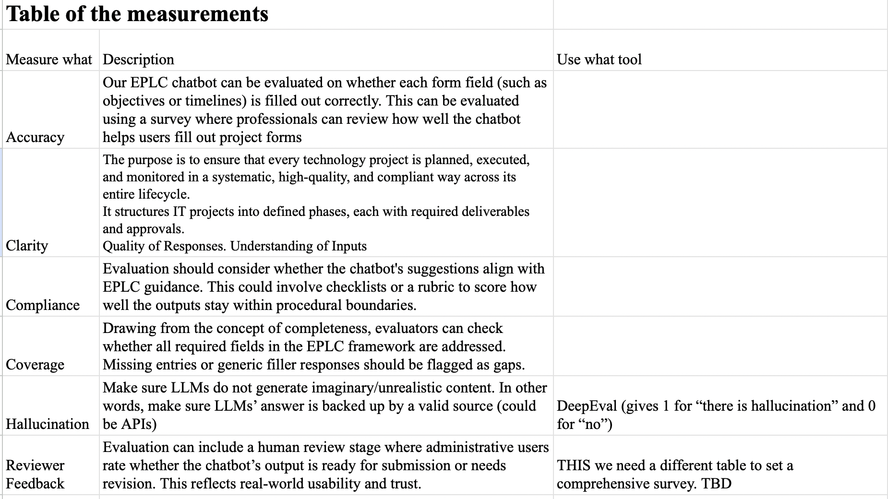
Evaluation & Compliance Team
We have identified key performance considerations based on the Chatbot feature, and created a evaluation matrix chart based on the literature review and research related to similar topics.
We will further refine and tailor these metrics once the team make an agreement on the output.
Next step we will develop a survey for the professionals to evaluate the accuracy, completeness, and clarity of the form fields filled by the EPLC chatbot.
Notes:
survey design to evaluate the chatbot effectively

Slide 15
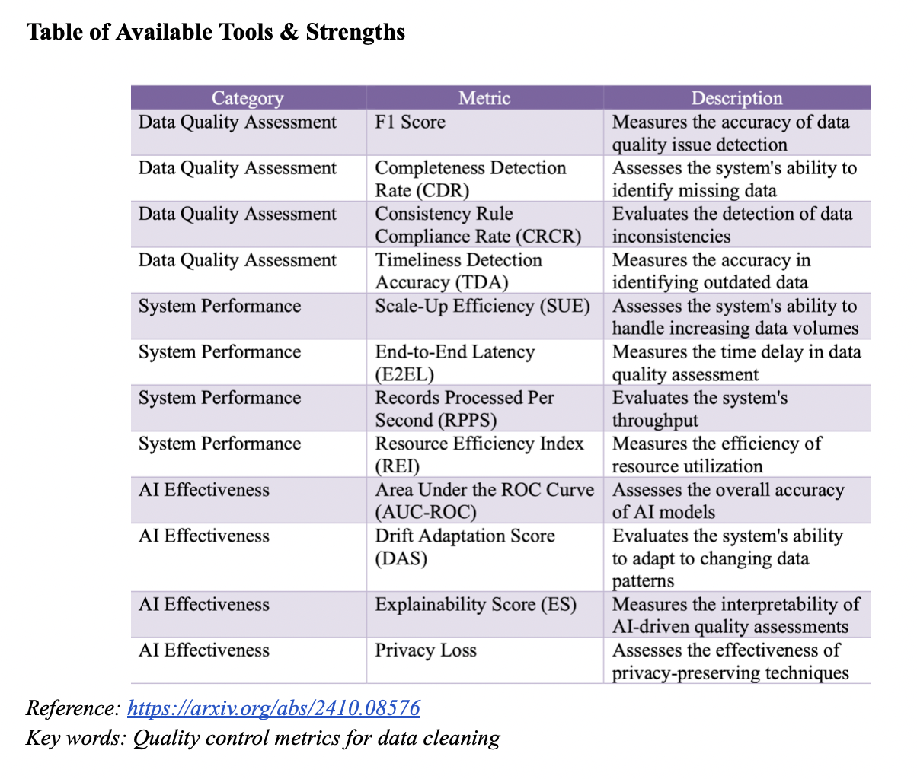

Slide 16
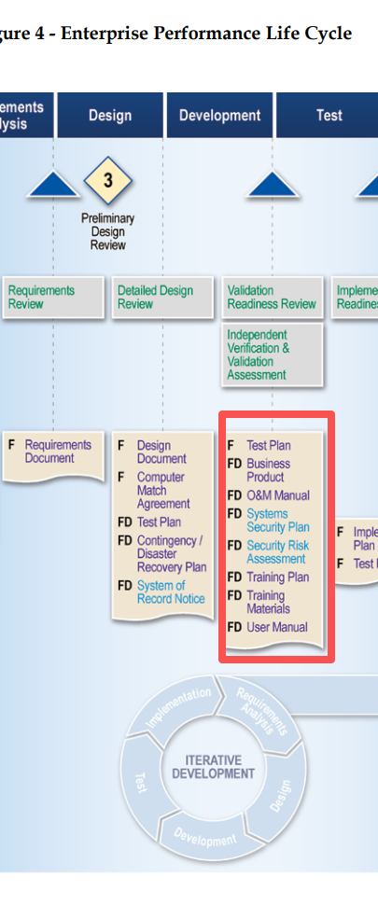
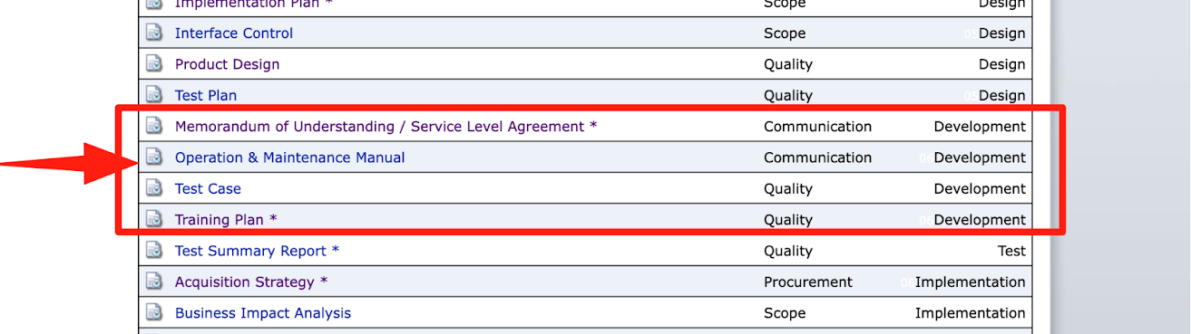
Questions
Q1: The difference between EPLC required documents and given templates
Required but don’t have templates:
Business Product
Systems Security Plan
Security Risk Assessment
Training Materials
User Manual
Required and have templates:
Test Plan (/&Test Case)
O&M Manual

Slide 17
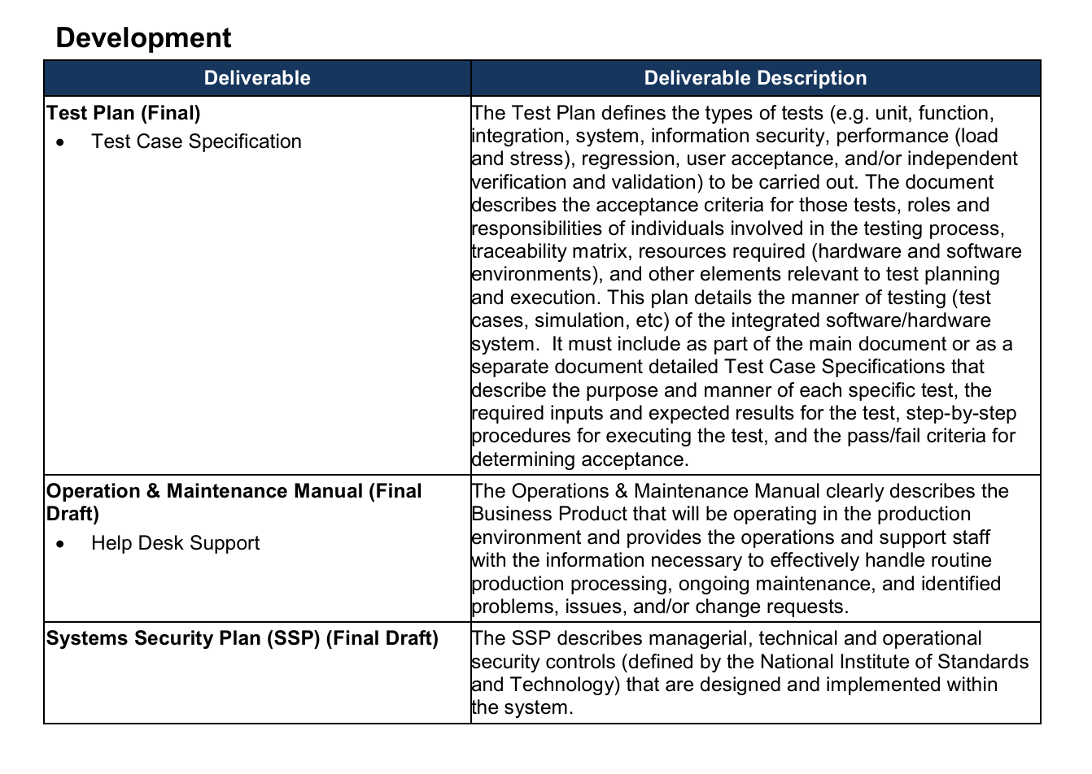
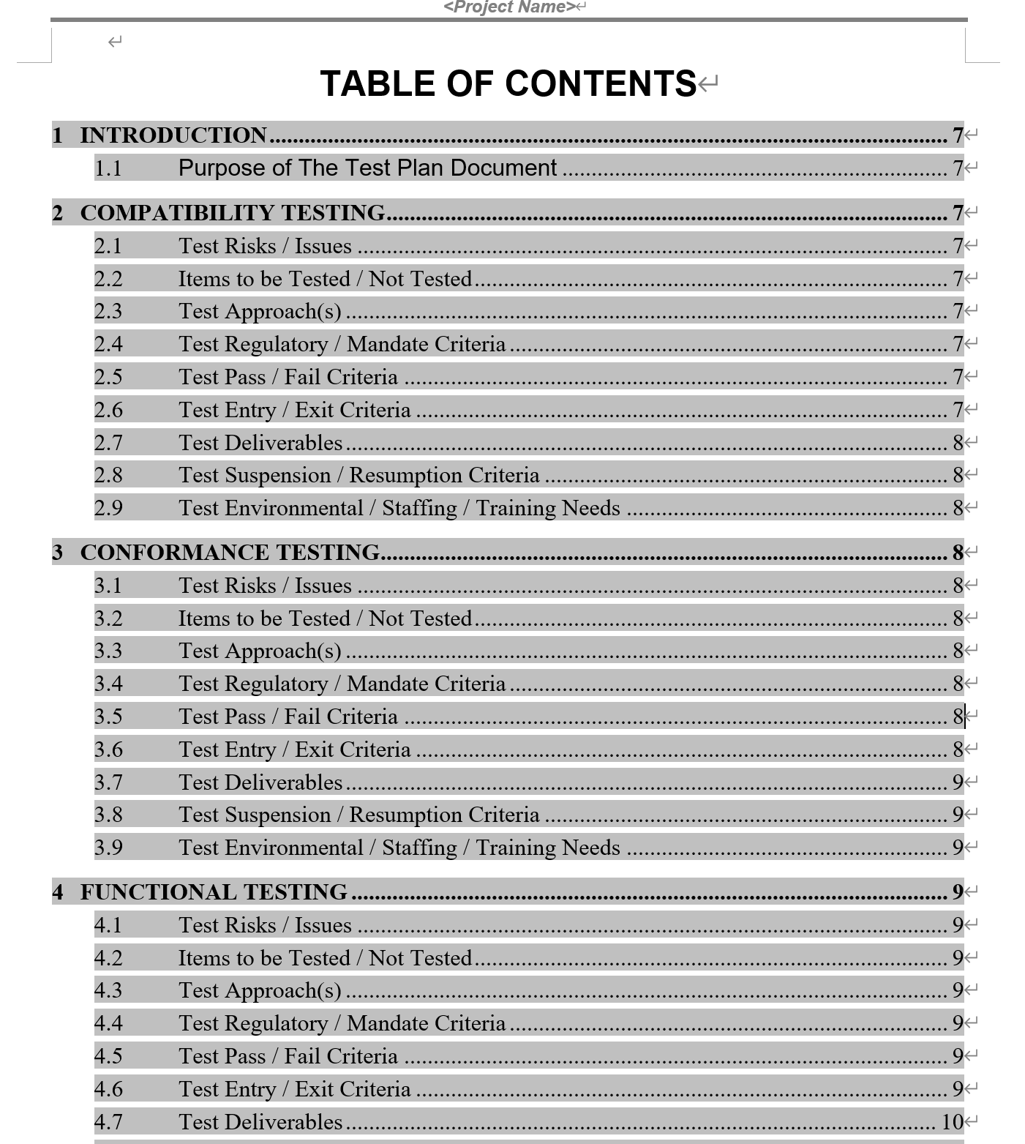
Q2: Whether the policy that we need to validate is the content need to include provided by EPLC Framework, and so we need to extract the description and see what needs to be included in every documents；or refer to template’s content is enough

Slide 18
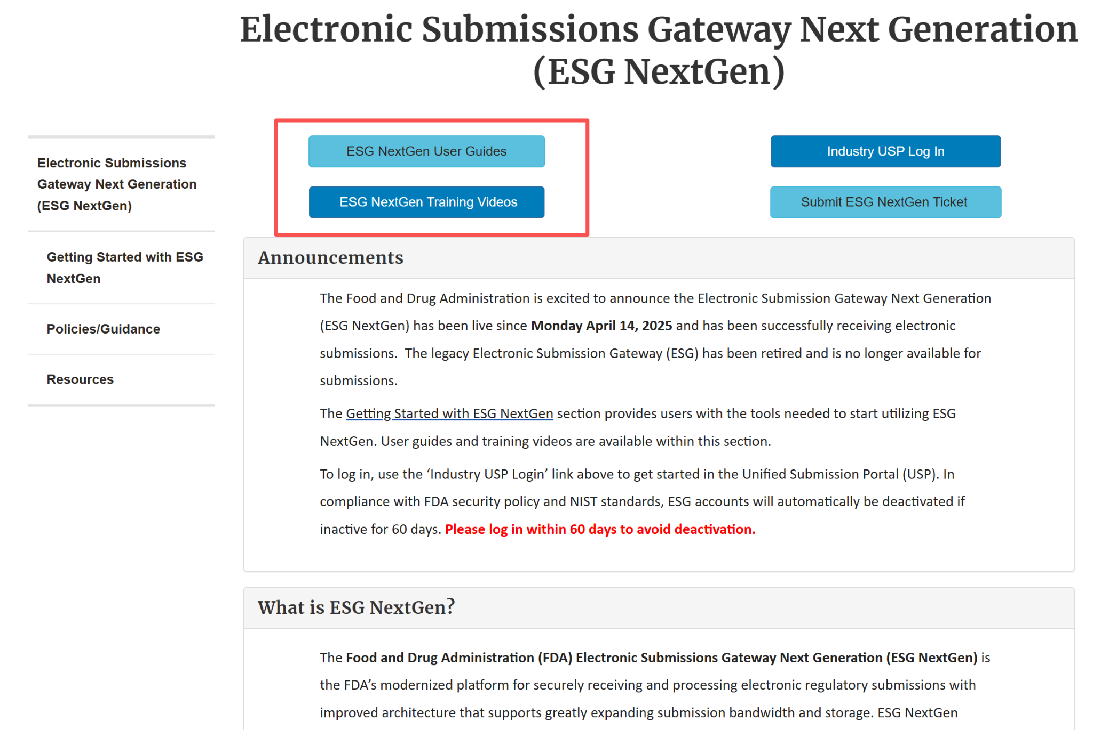
Q3: How could we better utilize the given use case (ESGNextGen, IBM) to achieve our goal, as there is seems only the user manual could be refer to.

Slide 19
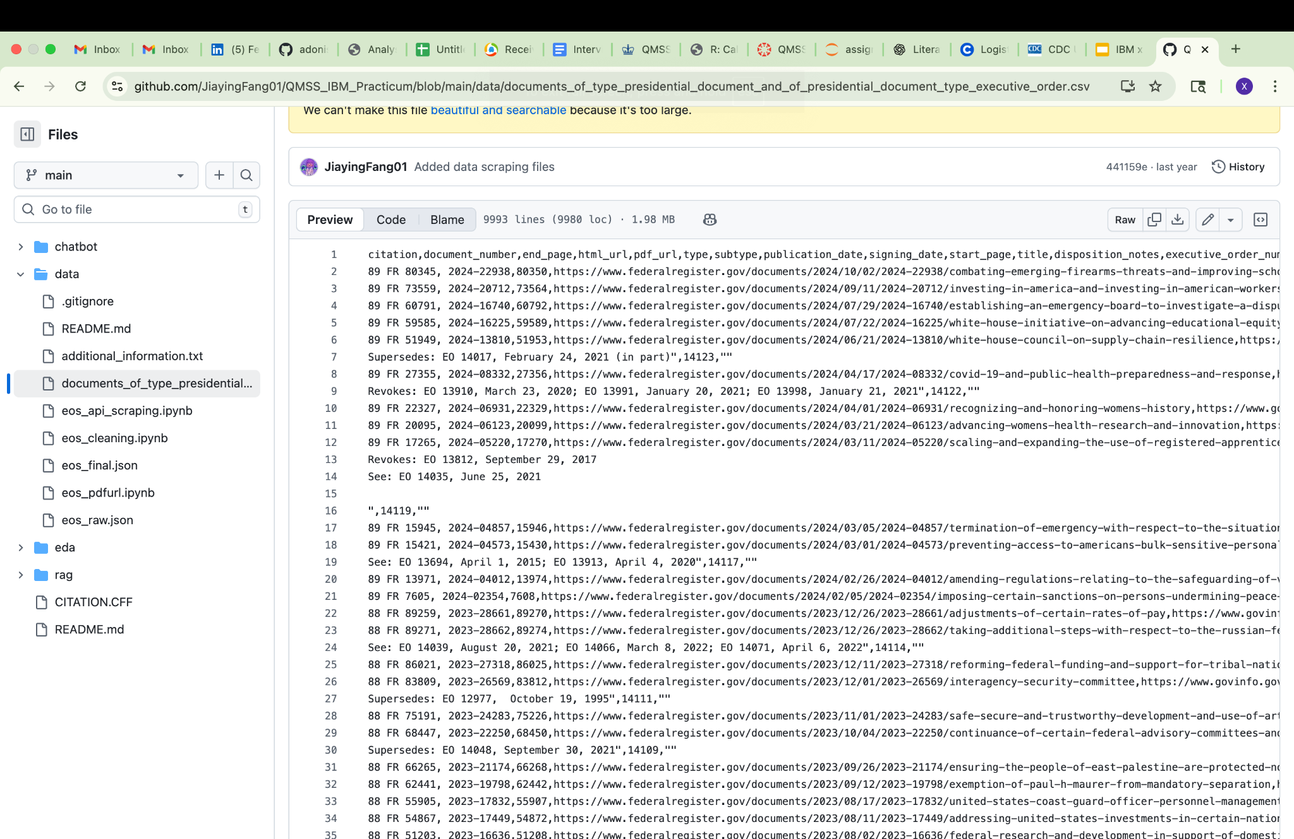
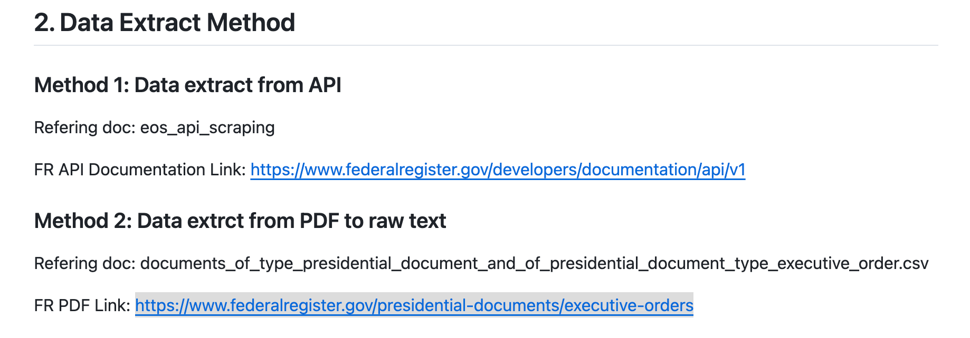
Q4: Are we expected to create a similar structured dataset (with defined columns and metadata) from the EPLC materials? If so, could you please clarify how we should approach data extraction and organization?

Slide 20

NEXT
STEPS
Keep up with the timeline, communicate with the sub-team for better support. Diving into the topics we’ve touched on today to deepen our understanding on the project, and starting the data preparation procedure.

Slide 21
THANK
YOU!
IBM x Columbia
10 / 2025
Columbia Practicum Core Team

